Slide 1
An Overview of Canada’s Dairy System
Ralph Dietrich, Chair, Dairy Farmers of Ontario
Murray Sherk, Vice Chair, Dairy farmers of Ontario
March 2018

Slide 2
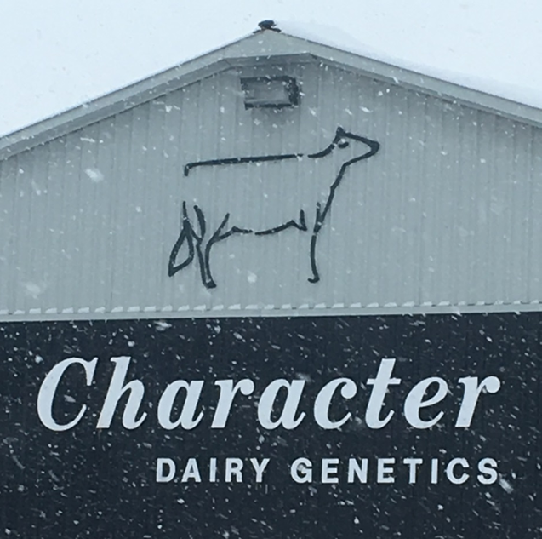
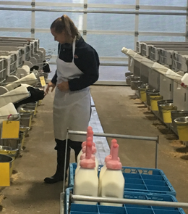
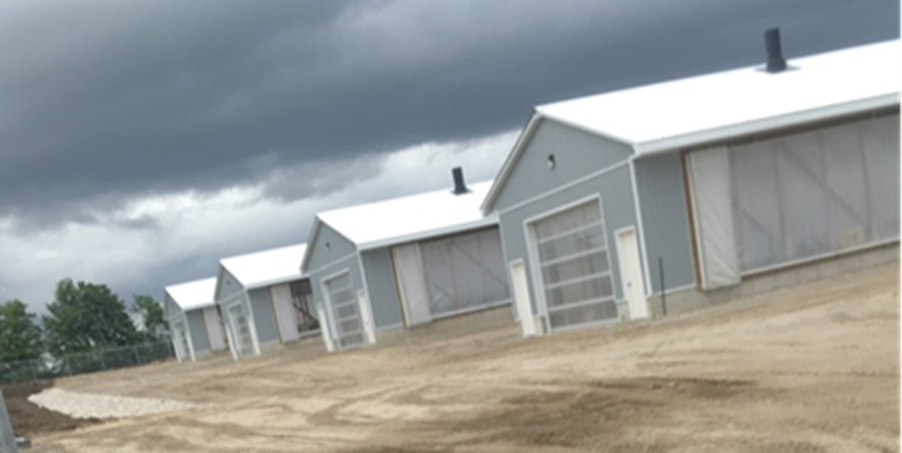

Slide 3
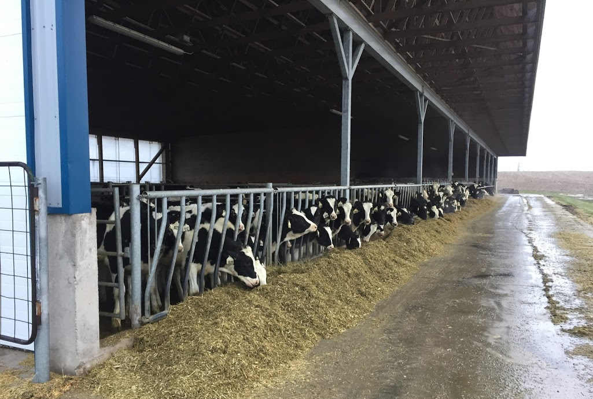
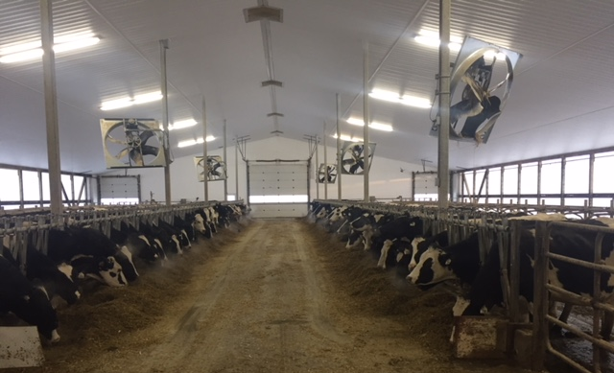
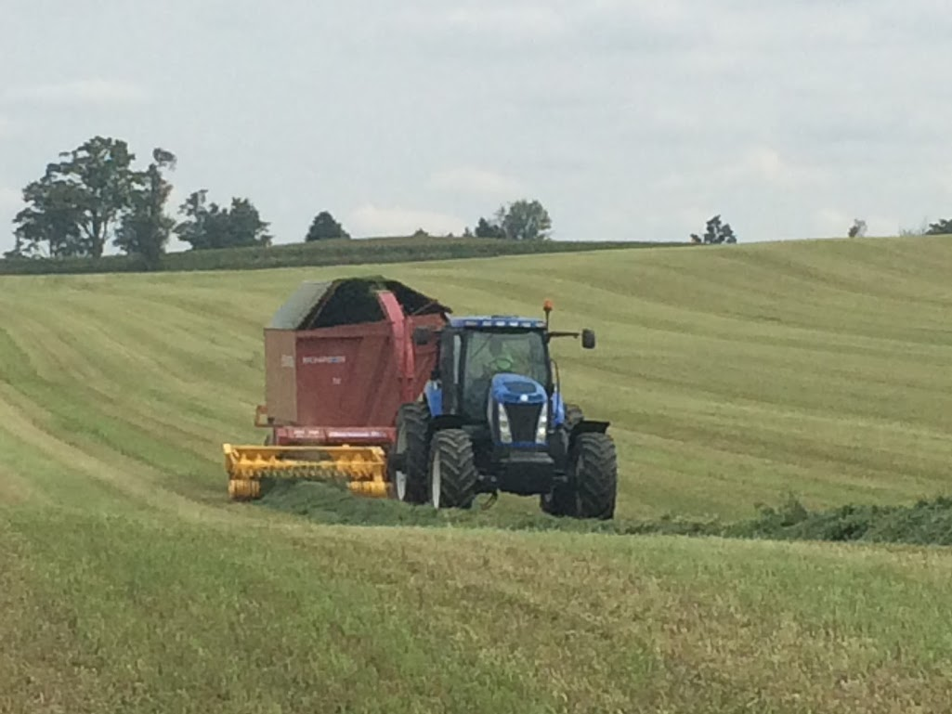
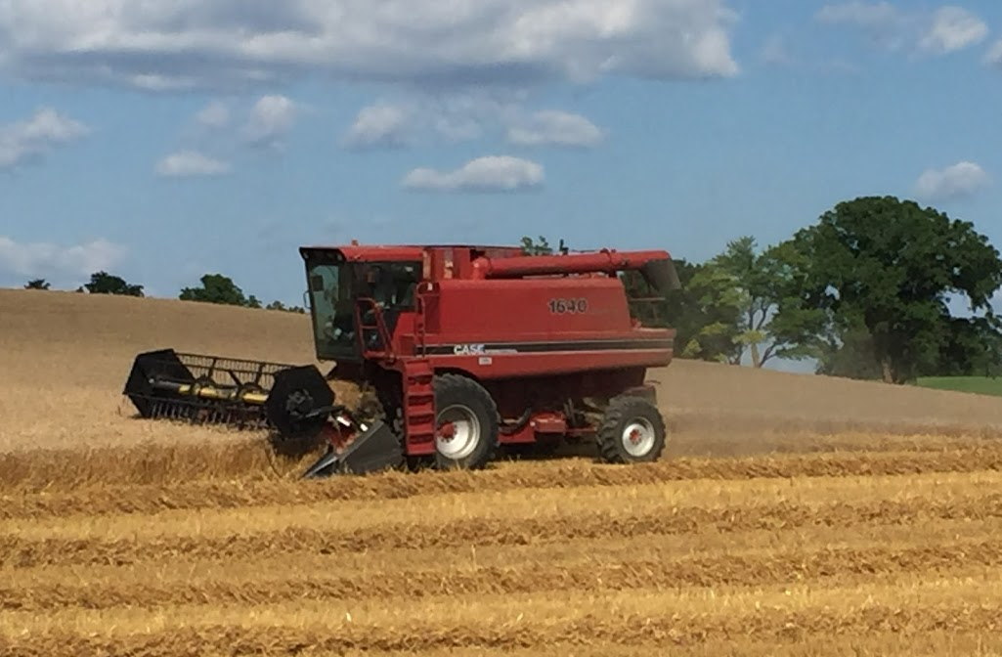
130 Cow Dairy / 500 acres

Slide 4
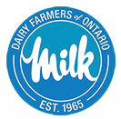
Dairy Farmers of Ontario (DFO)
DFO is the milk marketing board in Ontario
  Operated by dairy farmers in Ontario
  managed by Board of 12 dairy farmers
  staff of 85 people
  Operating budget $120 Million
  Managing 3 Billion litres
  with value of almost $2.3B

Slide 5
Why are we here?

Slide 6
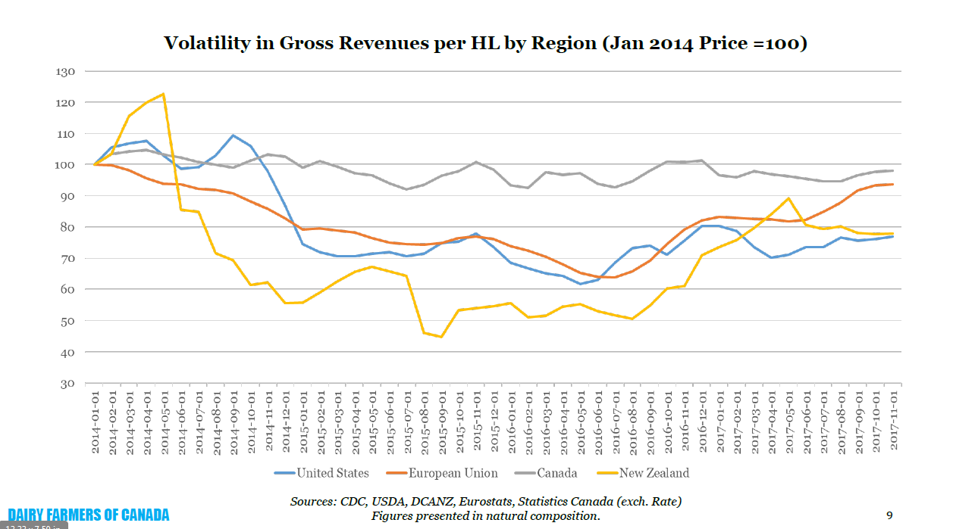

Slide 7
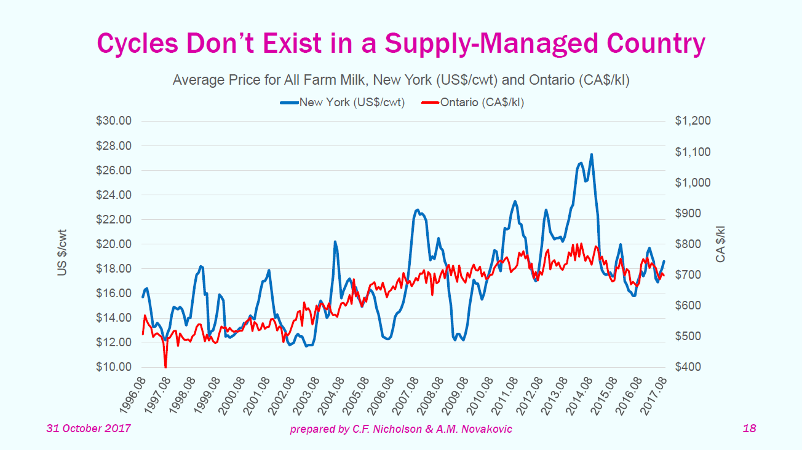

Slide 8
Industry Overview

Slide 9
Dairy Industry Comparison
WI CAN ONT
Licenced farms 9,500 11,000 3,580
Production (bil. lbs) 30.1 20.9 7.0
Cows per farm 134 86 88

Slide 10
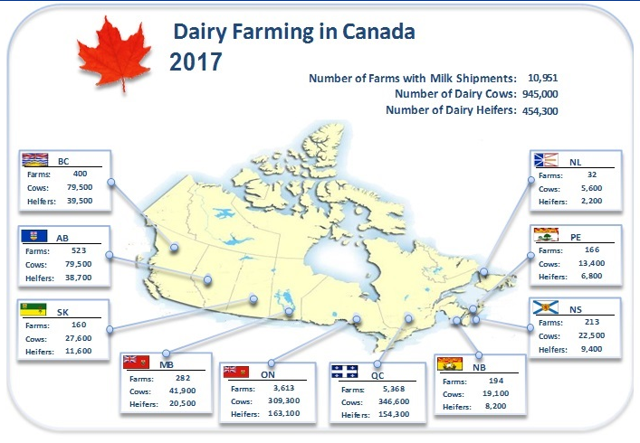

Slide 11
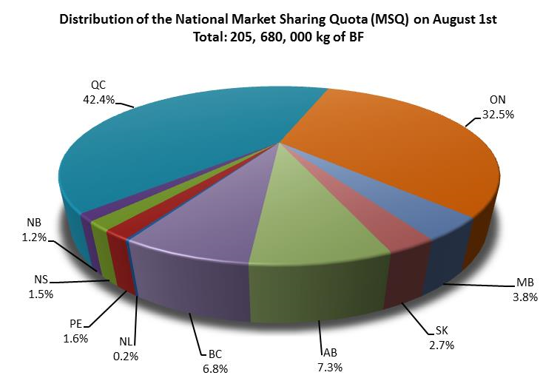

Slide 12


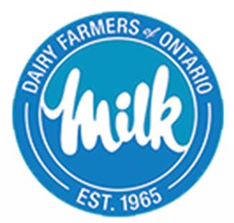
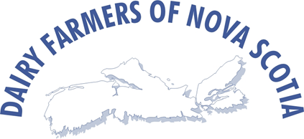

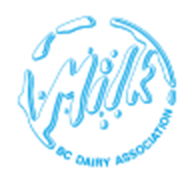
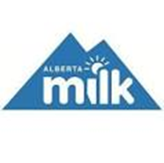


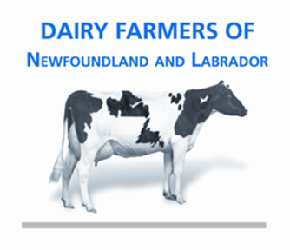
P5
Western Milk Pool

Slide 13
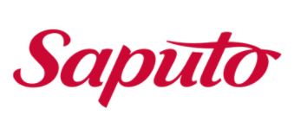
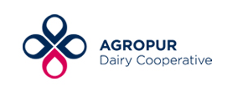
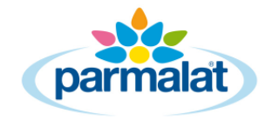

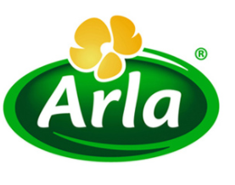
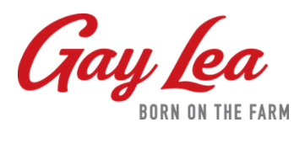
Processing
450 processors nationally
85 % of milk marketed to 4 processors

Slide 14
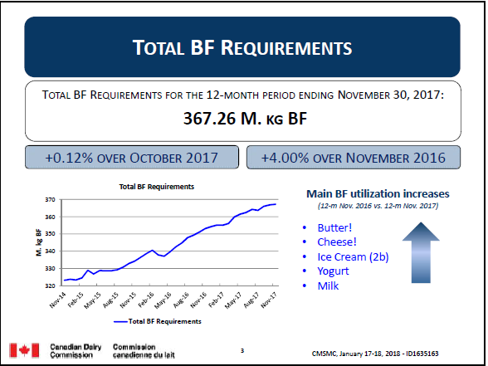
Market Growth

Slide 15
Historical Context

Slide 16
Historical Context
In 1960, Ontario milk producer organizations were fragmented and lacked unity in purpose.
Their bargaining position in the marketplace was very weak.
Returns to the vast majority of milk producers for labour, management and investment were inadequate
There were numerous inequities and inefficiencies in the milk marketing system.
Because of this chaos, the Ontario government commissioned a study in 1963 to determine how to solve what appeared to be an ever increasing problem.
The answer came in the form of the Milk Act, which was passed in 1965.

Slide 17
Historical Context
The Milk Act called for an intermediate body that would buy all the milk produced on Ontario farms and sell that milk to the processors.
That body was the Ontario Milk Marketing Board (OMMB).
The Ontario Milk Marketing Board successfully addressed those marketing problems and worked on responding to a continuously evolving set of domestic and international market changes

Slide 18
Historical Context
The Dairy Farmers of Ontario was formed on August 1, 1995 following the merger of the Ontario Milk Marketing Board and the Ontario Cream Producers' Marketing Board.
The activities of DFO are monitored by the Ontario Farm Products Marketing commission.
The Board is also subject to decisions of the Ontario Farm Products Appeal Tribunal which hears appeals from parties dissatisfied with Board Decisions.

Slide 19
Canadas Dairy System

Slide 20
What Is Canada’s Dairy System
System known as Supply Management
What is supply management?
Canada’s supply management system provides balance in the dairy sector by enabling Canadian dairy farmers to act collectively to negotiate price and adjust milk production to meet consumer demand.

Slide 21
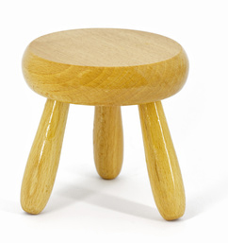
What Is Canada’s Dairy System
Three Pillars
Producer Pricing
Production Discipline
Import Control

Slide 22
What Is Canada’s Dairy System
Marketing Boards
Farmer managed, derive authority from provincial legislation
All milk in the province sold to the provincial Board
Boards look after all logistics of milk pickup and delivery to plants

Slide 23
What Is Canada’s Dairy System
At National Level Market Requirements are determined that meet domestic consumer demand and avoid overproduction of BF
National Production Quota issued to Provinces on percentage basis
Provinces issue Quota to producers
Quota Exchange to buy/sell between producers

Slide 24
What Is Canada’s Dairy System
Players

Slide 25
Players – 10 Provincial Boards
P5
Western Milk Pool

Slide 26

Players
Under the Canadian Dairy Commission Act, the CDC's legislated objectives are:
  to provide efficient producers of milk and cream with the opportunity to obtain a fair return for their labour and investment; and
  to provide consumers of dairy products with a continuous and adequate supply of dairy products of high quality.
CDC strives to balance and serve the interests of all dairy stakeholders - producers, processors, further processors, exporters, consumers and governments.

Slide 27
Players
Canadian Milk Supply Management Committee
  Farmers (provincial boards), Processors, CDC
  Oversight by Provincial Government Ministries of Agriculture
Dairy Farmers of Canada
  national policy, lobbying and promotional programs
  All provincial boards are members

Slide 28
Pricing
Milk Pricing
  Changes in Farm Gate Price of milk classes 1-4 determined by:
    50% change in average Cost of Production
    50% change in Consumer Price Index
  Some Classes set at world price
  Average blend price today about Cdn $73/hL or US$27/cwt

Slide 29
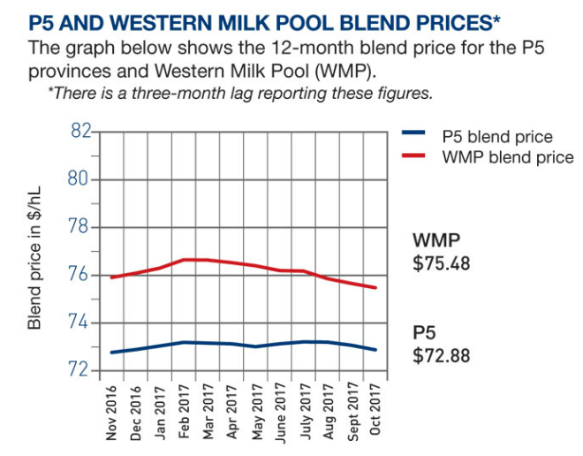
Pricing

Slide 30
Retail Pricing
Set by retailers
4L milk typically
  Cdn $4.29/4 litres
  US $ 3.26/gal
Butter typically
  Cdn $3.00-$4.00/lb
  US $2.40 - $$3.20

Slide 31
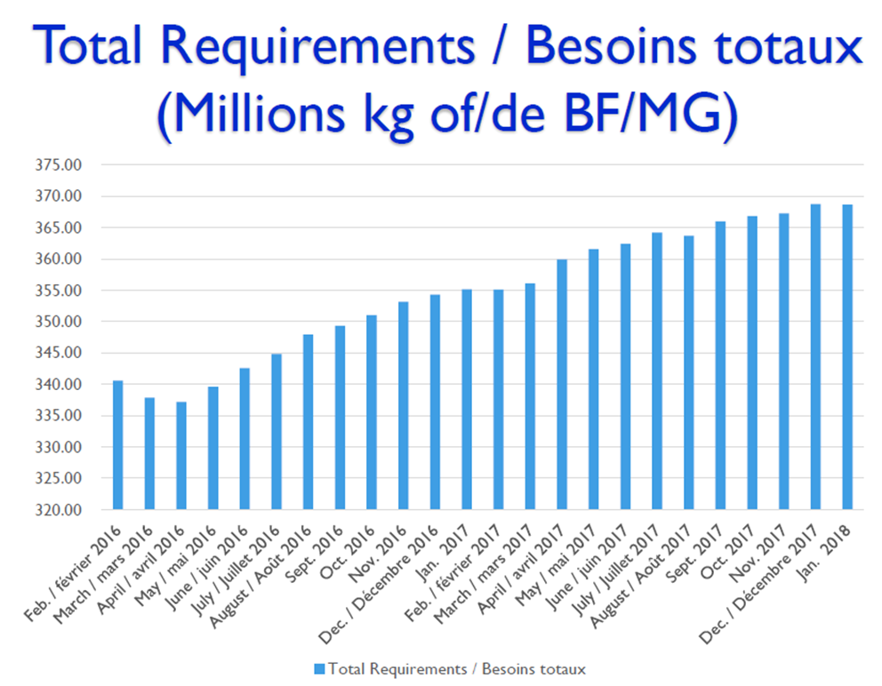

Slide 32
Quota Growth
Last 3 years more than 24% new Quota at Farm level
That means more production at the farm at stable pricing, which means more investment
Processors in last 2 years have begun and committed more than $600 million new processing capacity

Slide 33
Summary of Canadian System
Canada’s supply management system provides balance in the dairy sector by enabling Canadian dairy farmers to act collectively to negotiate price and adjust milk production to meet consumer demand.
While farmers around the world face unexpected wild market fluctuations, Canadian farmers sell their milk at constant and stable prices.
As a result, Canadian dairy farming is one of the few agricultural sectors that are self-sufficient – providing income security for farmers and requiring no government subsidy. This means Canadian farmers can invest in their farms, communities and Canada.

Slide 34
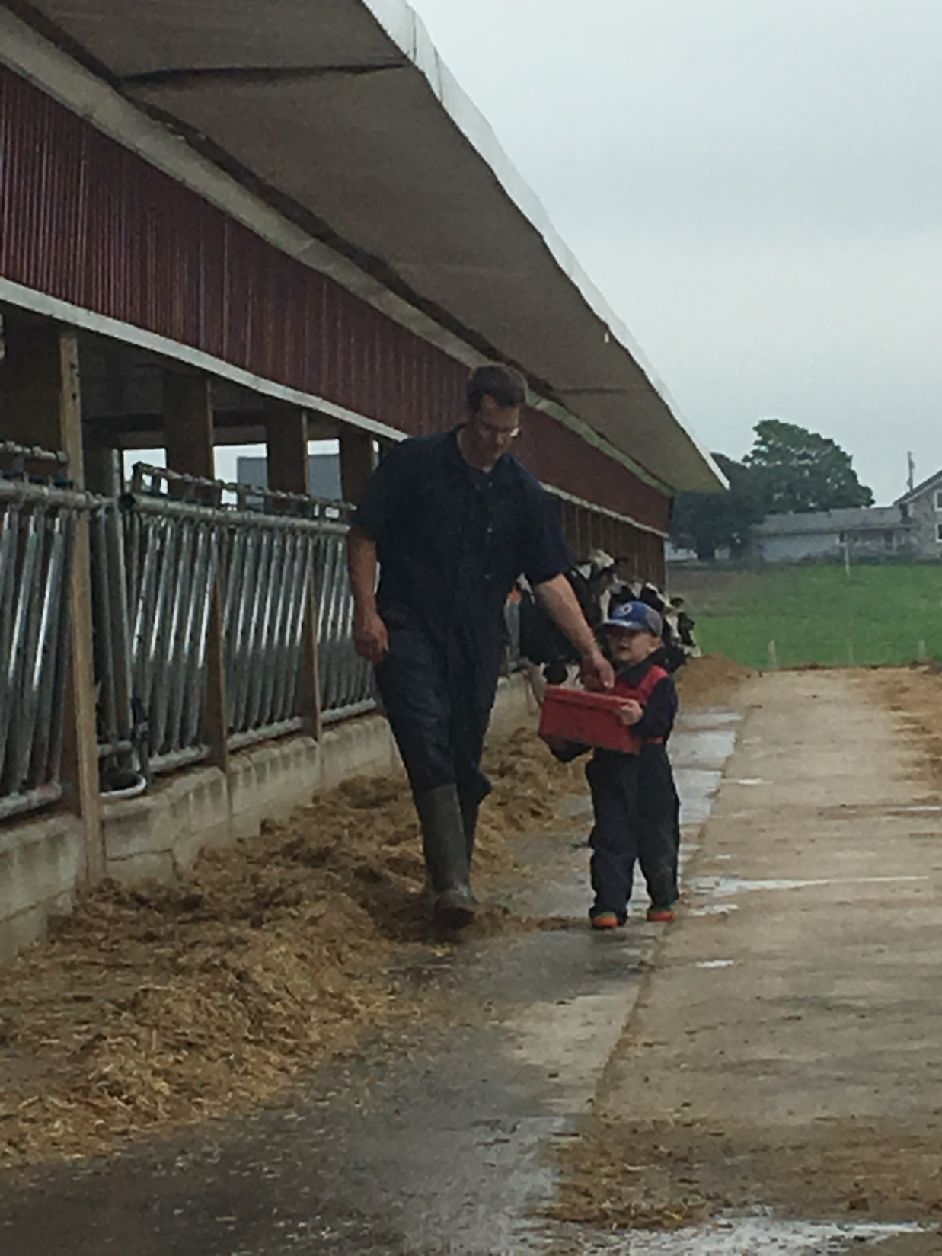

Slide 35


Slide 37
Extra Slides

Slide 38
What Is Canada’s Dairy System
Players
10 Provincial Marketing Boards of Farmers
Nationally Canadian Dairy Commission
Canadian Milk Supply Management Committee of Farmers, Processors, Government
Oversight by Provincial Government Ministries of Agriculture

Slide 39
What Is Canada’s Dairy System
Pools
  P5 - Ontario, Quebec and Maritime provinces
  WMP - British Columbia, Alberta, Saskatchewan, Manitoba

Slide 40
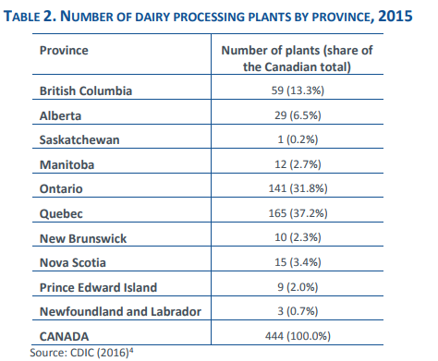

Slide 41
Dairy Trade Balance Canada-US
Source: Canadian Dairy Information Centre
Notes:
To put things in perspective, the graph shows that US has been largely benefiting from trading dairy commodities with Canada, regardless of the fact that some of these imports have entered under the IREP program. If trade deficit is a critical objective in these negotiations for the US administration, dairy is not to be blamed for the US trade deficits.
A lot was said in the media recently on the dairy situation in the US.
President Trump heavily criticised Canadian dairy in early April in Wisconsin, blaming Canada for developing unfair policies and unilaterally changing the rules of trade... but there is a misunderstanding. For us in Canada, the heart of the US dairy issue is overproduction, but, for the US, its easier to blame Canada for a problem caused by their own dairy industry.

Slide 42
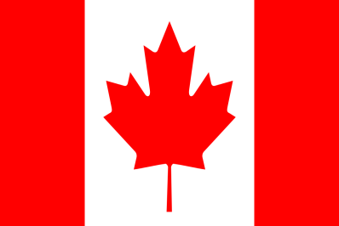
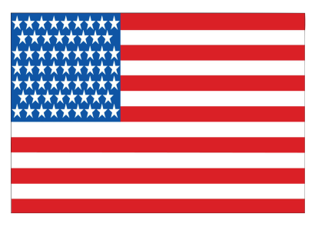
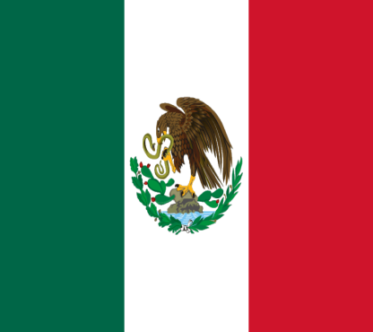
NAFTA in Numbers
GDP $1.8T
Pop. 36M
GDP $18.6T
Pop. 325M
GDP $2.3T
Pop. 130M

Slide 43
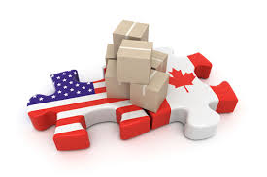
NAFTA – Trade Numbers
Canada and Mexico are US’ largest trading partners of almost every ag commodity → corn, soya beans, beef, hogs, wheat
Ontario alone is the #1 trade partner for 20 States

Slide 44
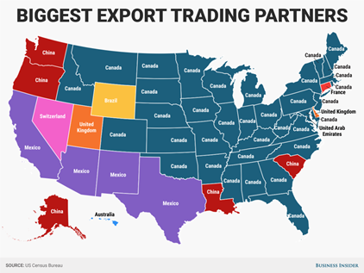
NAFTA

Slide 45
NAFTA – Trade Numbers
US ag trade surplus has doubled in the last 10 years
In 2016, Canada imported almost $1 billion ($971 million) in dairy, total dairy trade deficit of almost $735 million
  The US enjoyed a net trade surplus of almost half a billion dollars ($445 million)
35 States have Canada as #1 trade

Slide 47
Presentation Today
What is Canada’s Dairy System
  Who are the Players, How it works, Size
Growth In Canada
How We See NAFTA

Slide 48
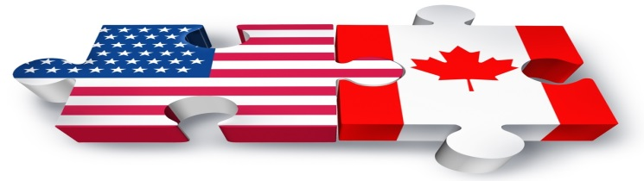
NAFTA - Background
Flag raised when President Trump visited Wisconsin two days after Parmalat notified Grasslands their order would stop
Some Americans believe Canadian government somehow closed the border; why?
US Administration wants “Class 7” reversed
Class 7 works as competitive compliant class for processing domestic skim milk

Slide 49
